Slide 1
Multiple Use Mold Casting Processes

Slide 2
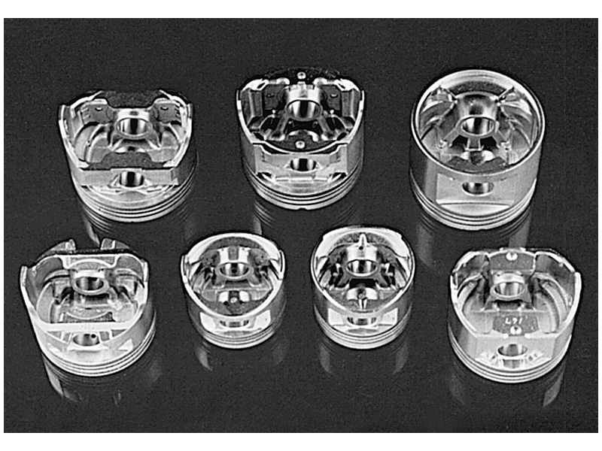
Pistons

Slide 3
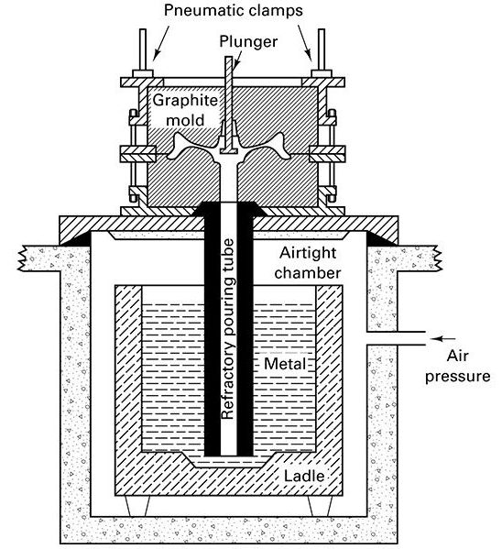
Low-pressure Permanent Mold Casting

Slide 4
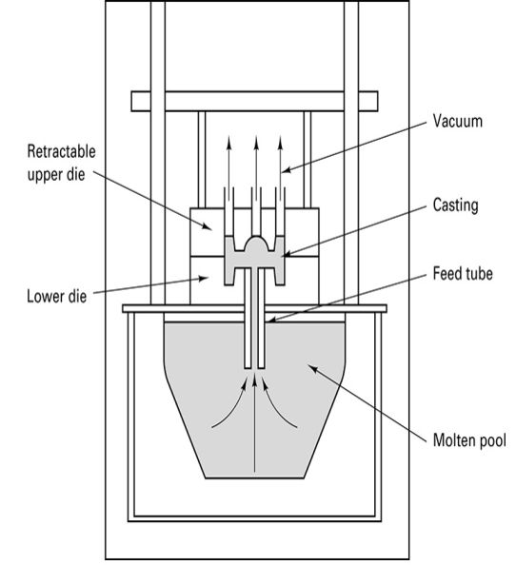
Vacuum Permanent-mold Casting

Slide 5
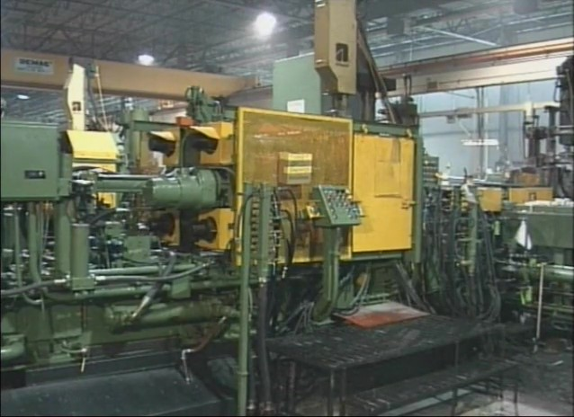
Watch Video Here
Notes:
Die Cast Machines

Slide 6
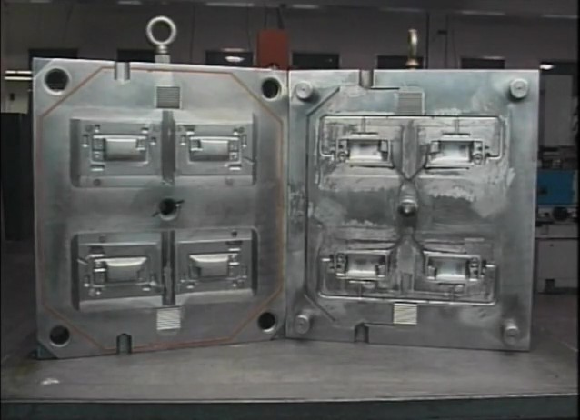
Watch Video Here
Notes:
Die Cast Tooling

Slide 7
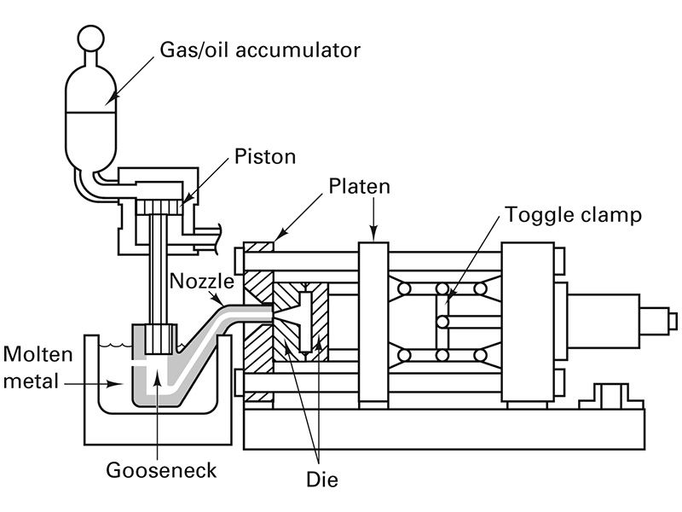
Hot-chamber Die Casting Machine

Slide 8
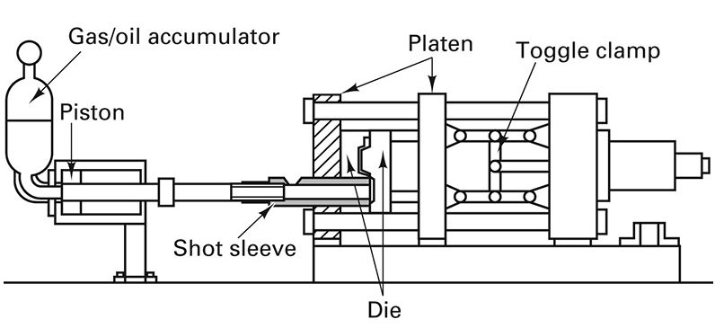
Cold-chamber Die Cast Machine

Slide 9
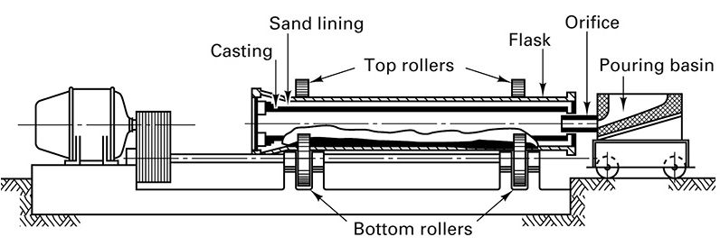
Horizontal Centrifugal Casting Machine

Slide 10
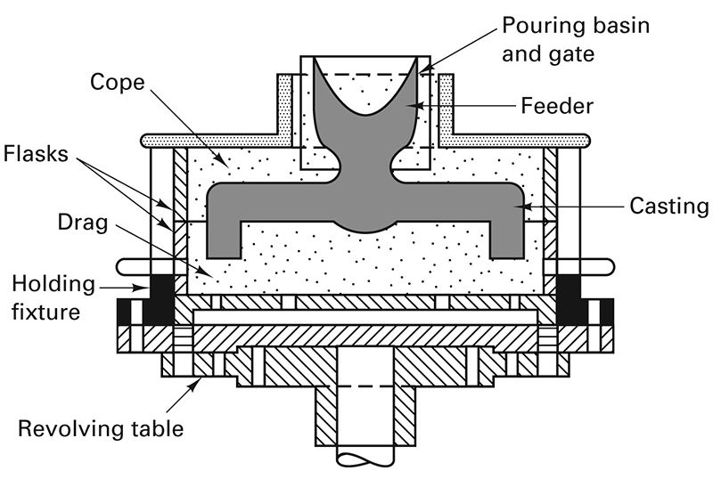
Semi-centrifugal Casting

Slide 11
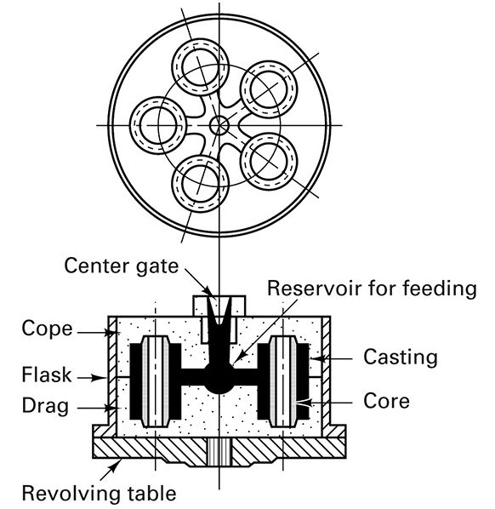
Centrifugal Casting

Slide 12
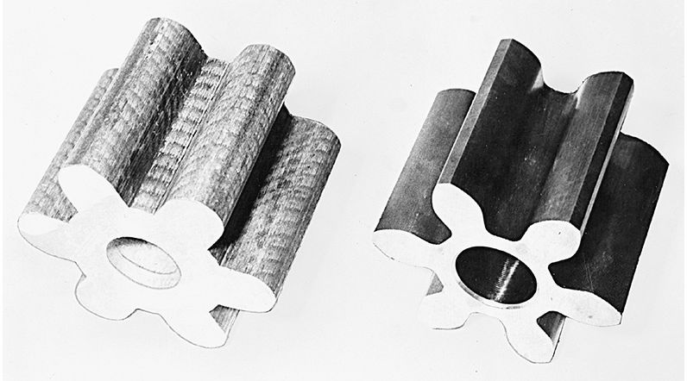
Gear produced by Continuous Casting

Slide 13
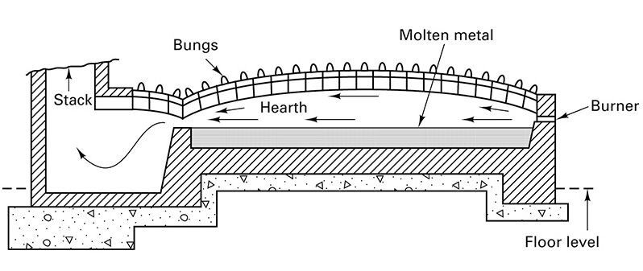
Direct Fuel-fired Furnace

Slide 14
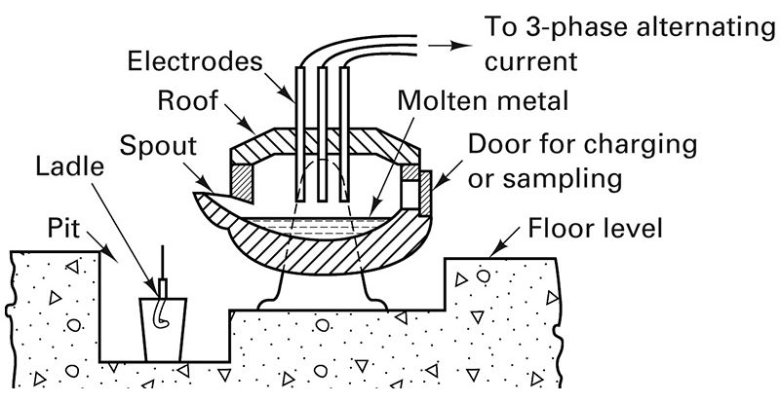
Three-phase Electric Arc Furnace diagram

Slide 15
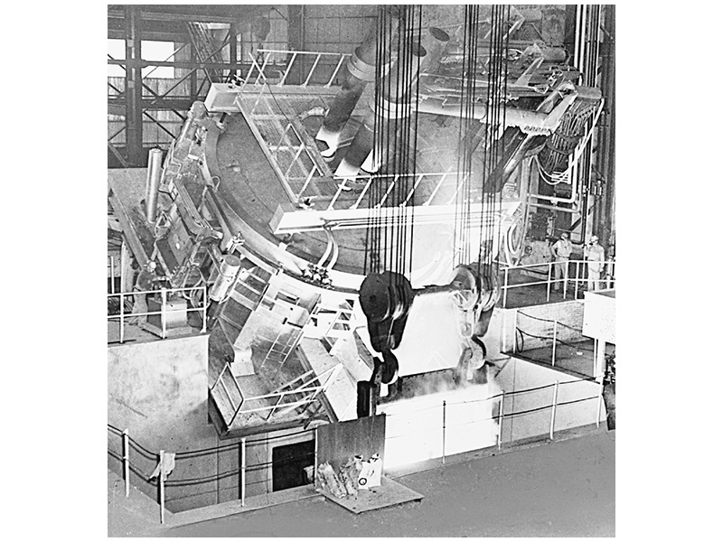
Electric-arc Furnace tilted for pouring

Slide 16
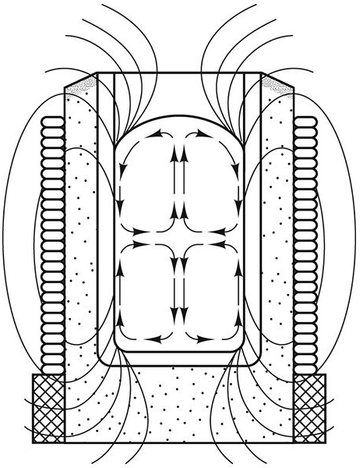
Coreless Induction Furnace

Slide 17
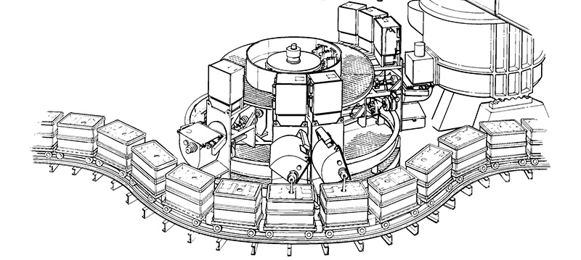
Automatic Pouring

Slide 18
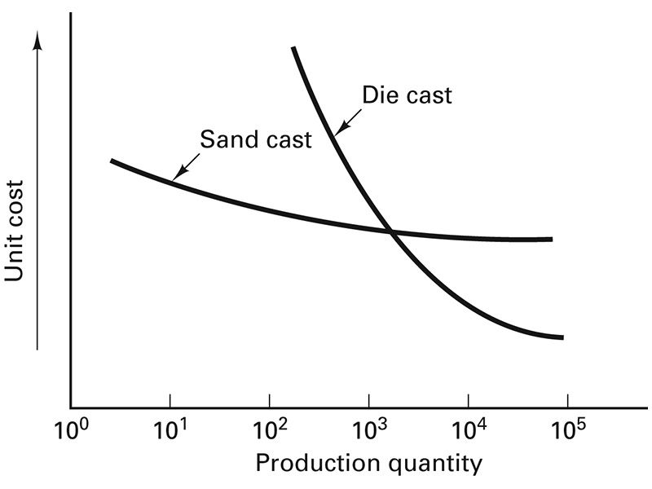
Unit Cost – Sand vs. Die

